Slide 1
Music@Home Figures

Slide 2
Study 1 Validity
eBMRQ
GoldMSI

Slide 3
Study 2 Validity
GoldMSI
BMRQ

Slide 4
Study 2 Validity
Adversity

Slide 5
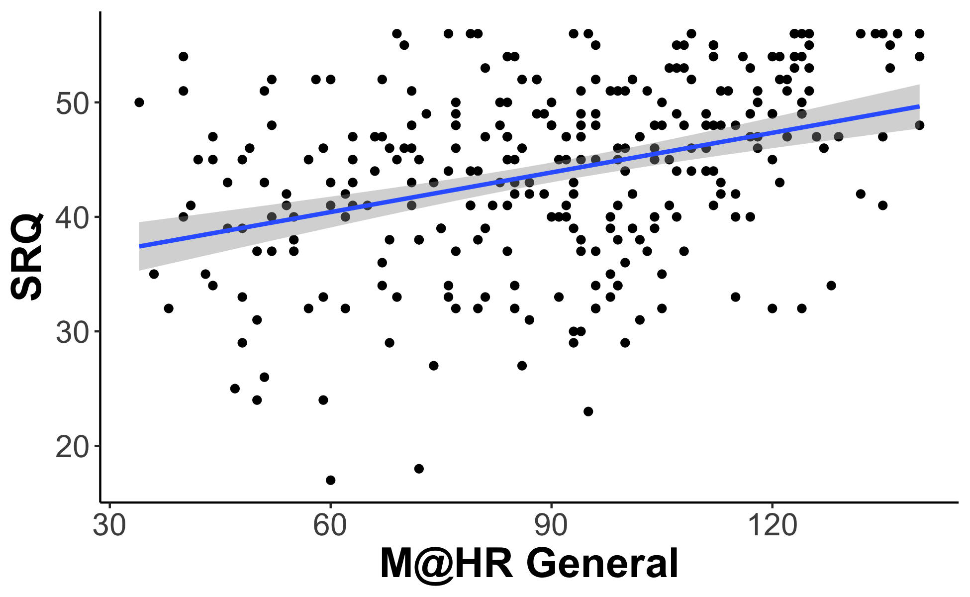
Study 2 Validity
SRQ

Slide 6
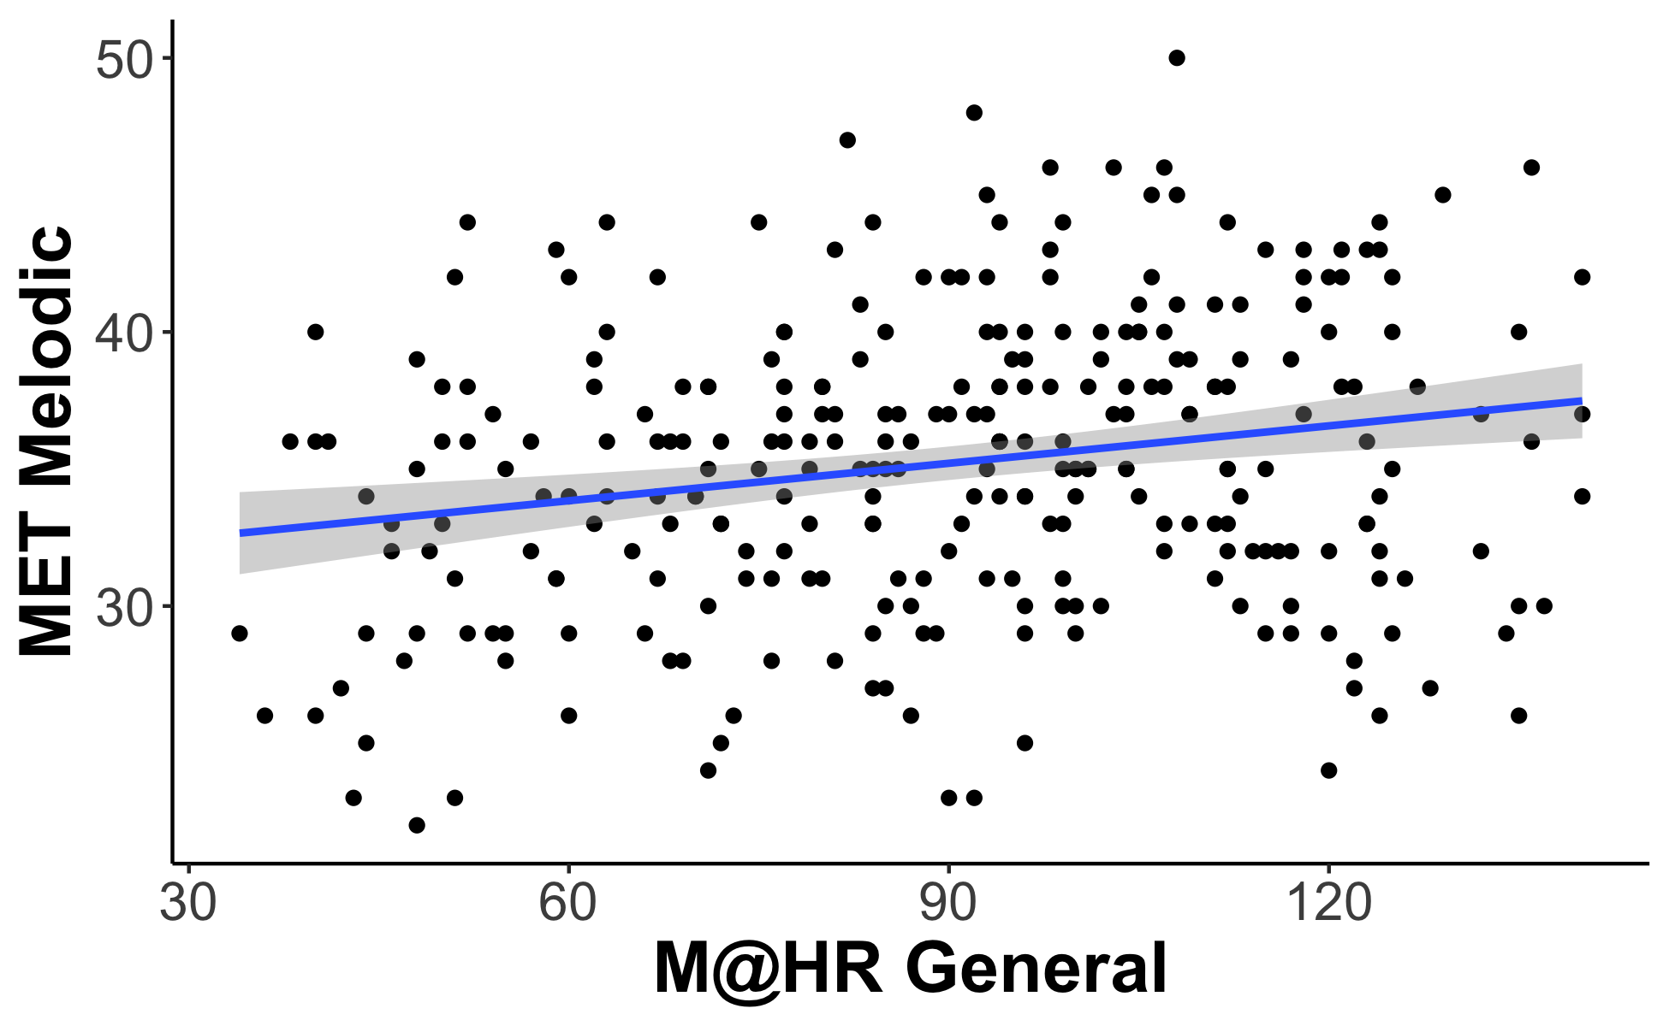
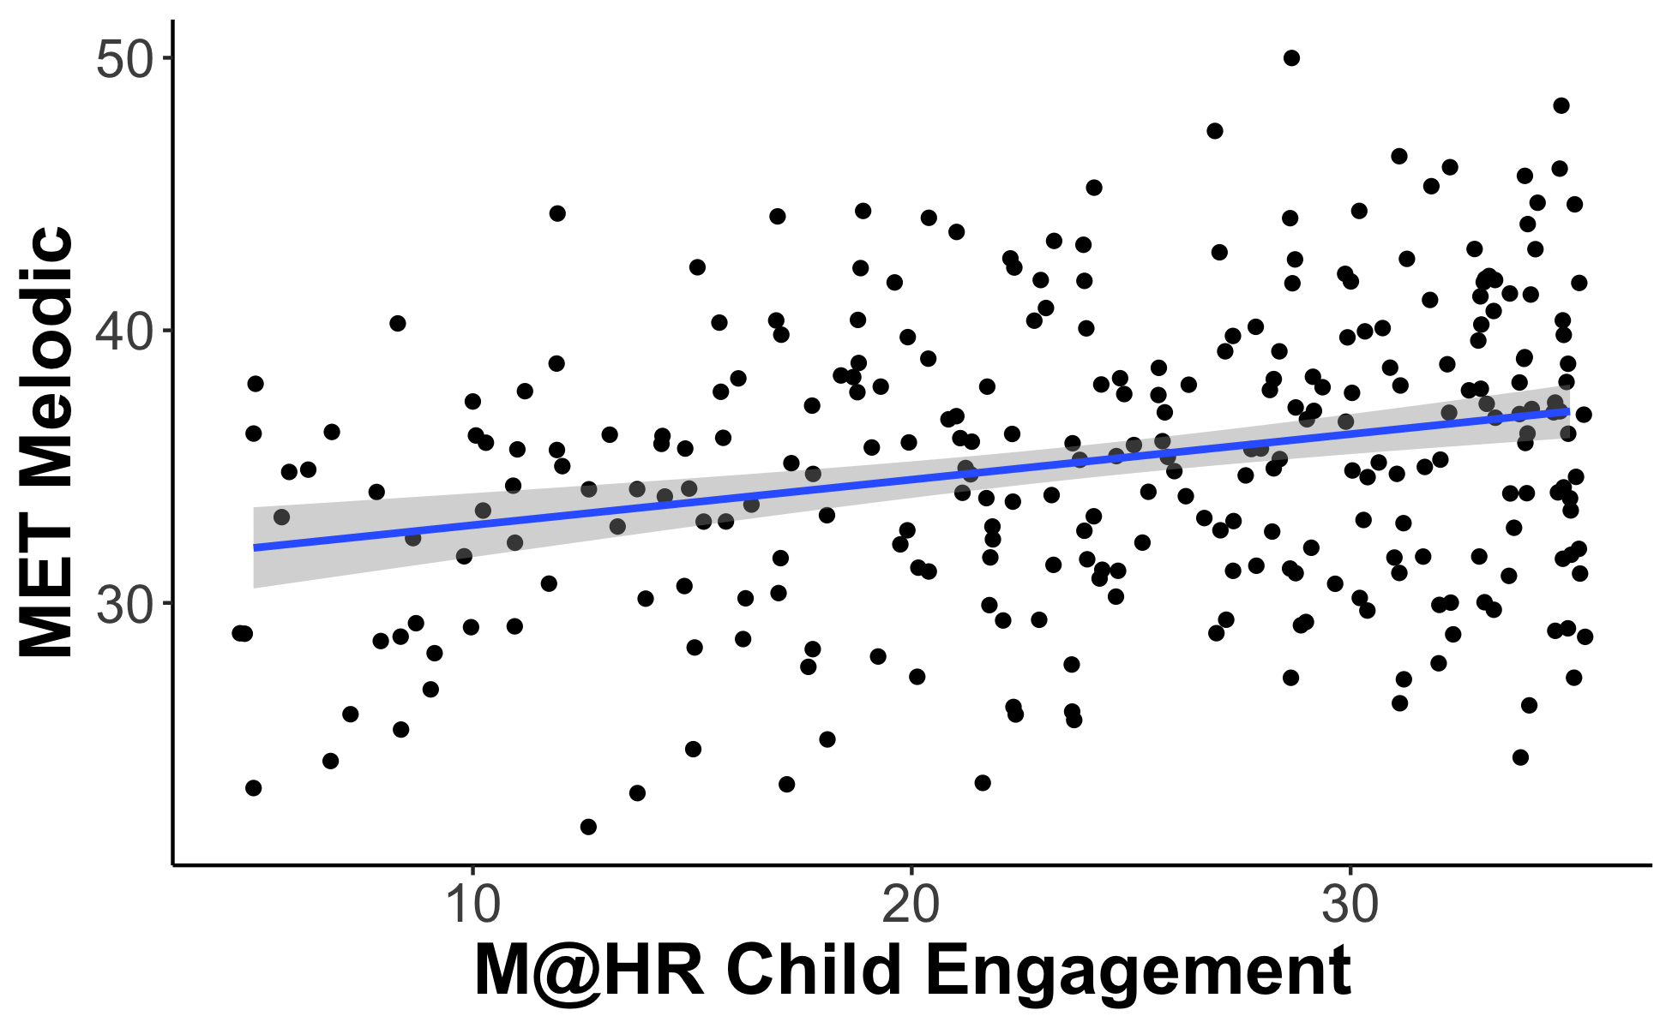
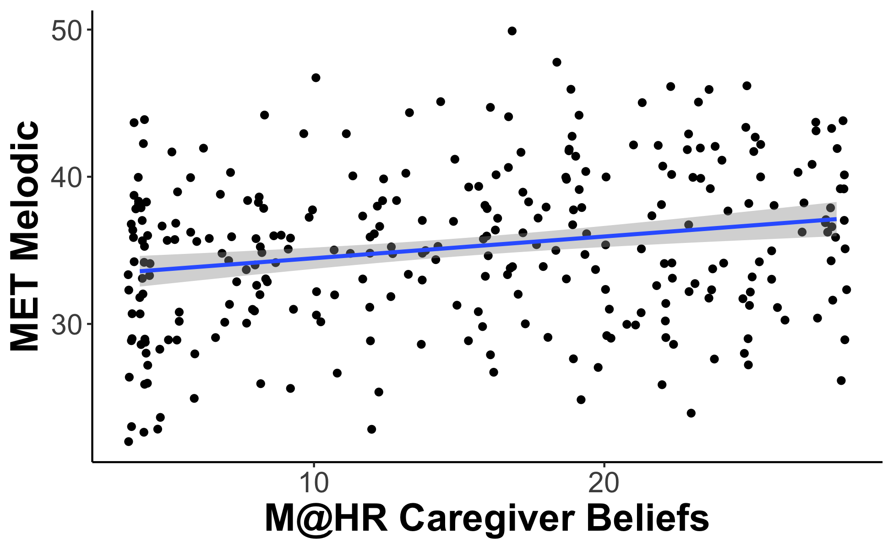
Utility of Scale: MET

Slide 7
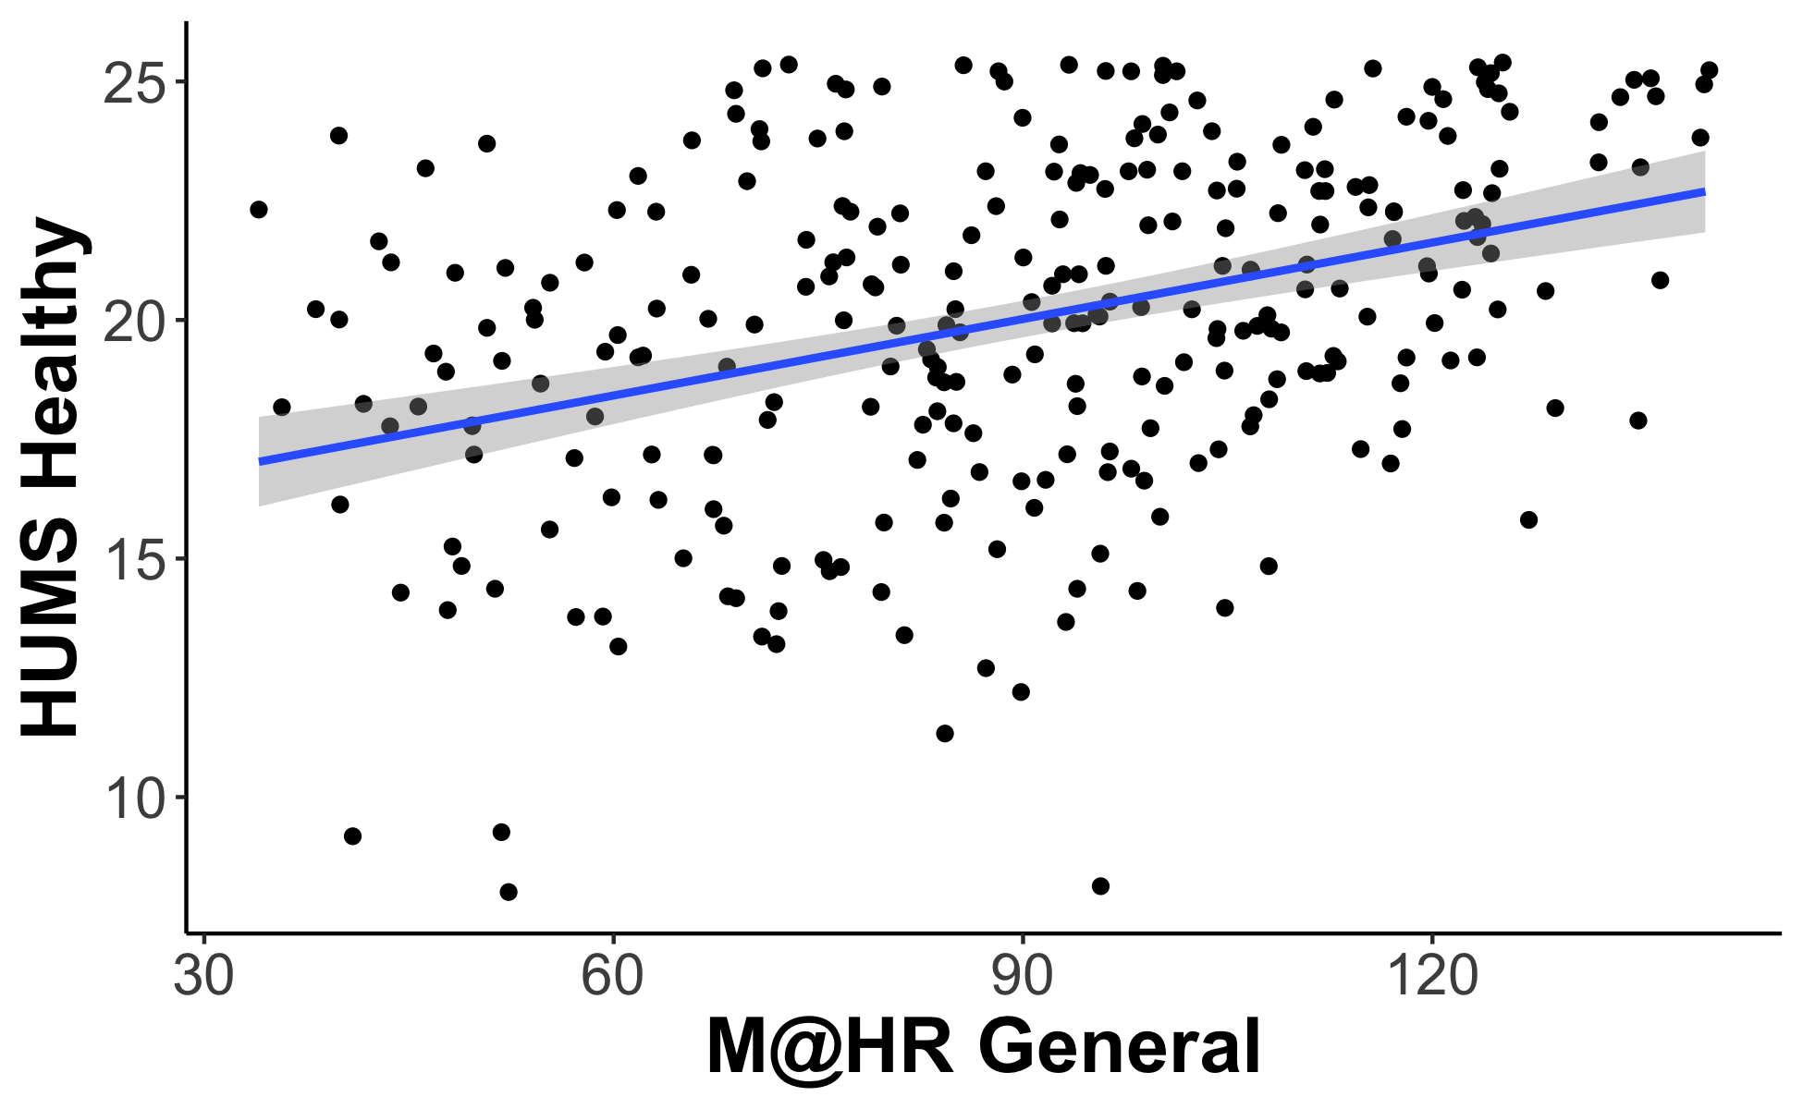
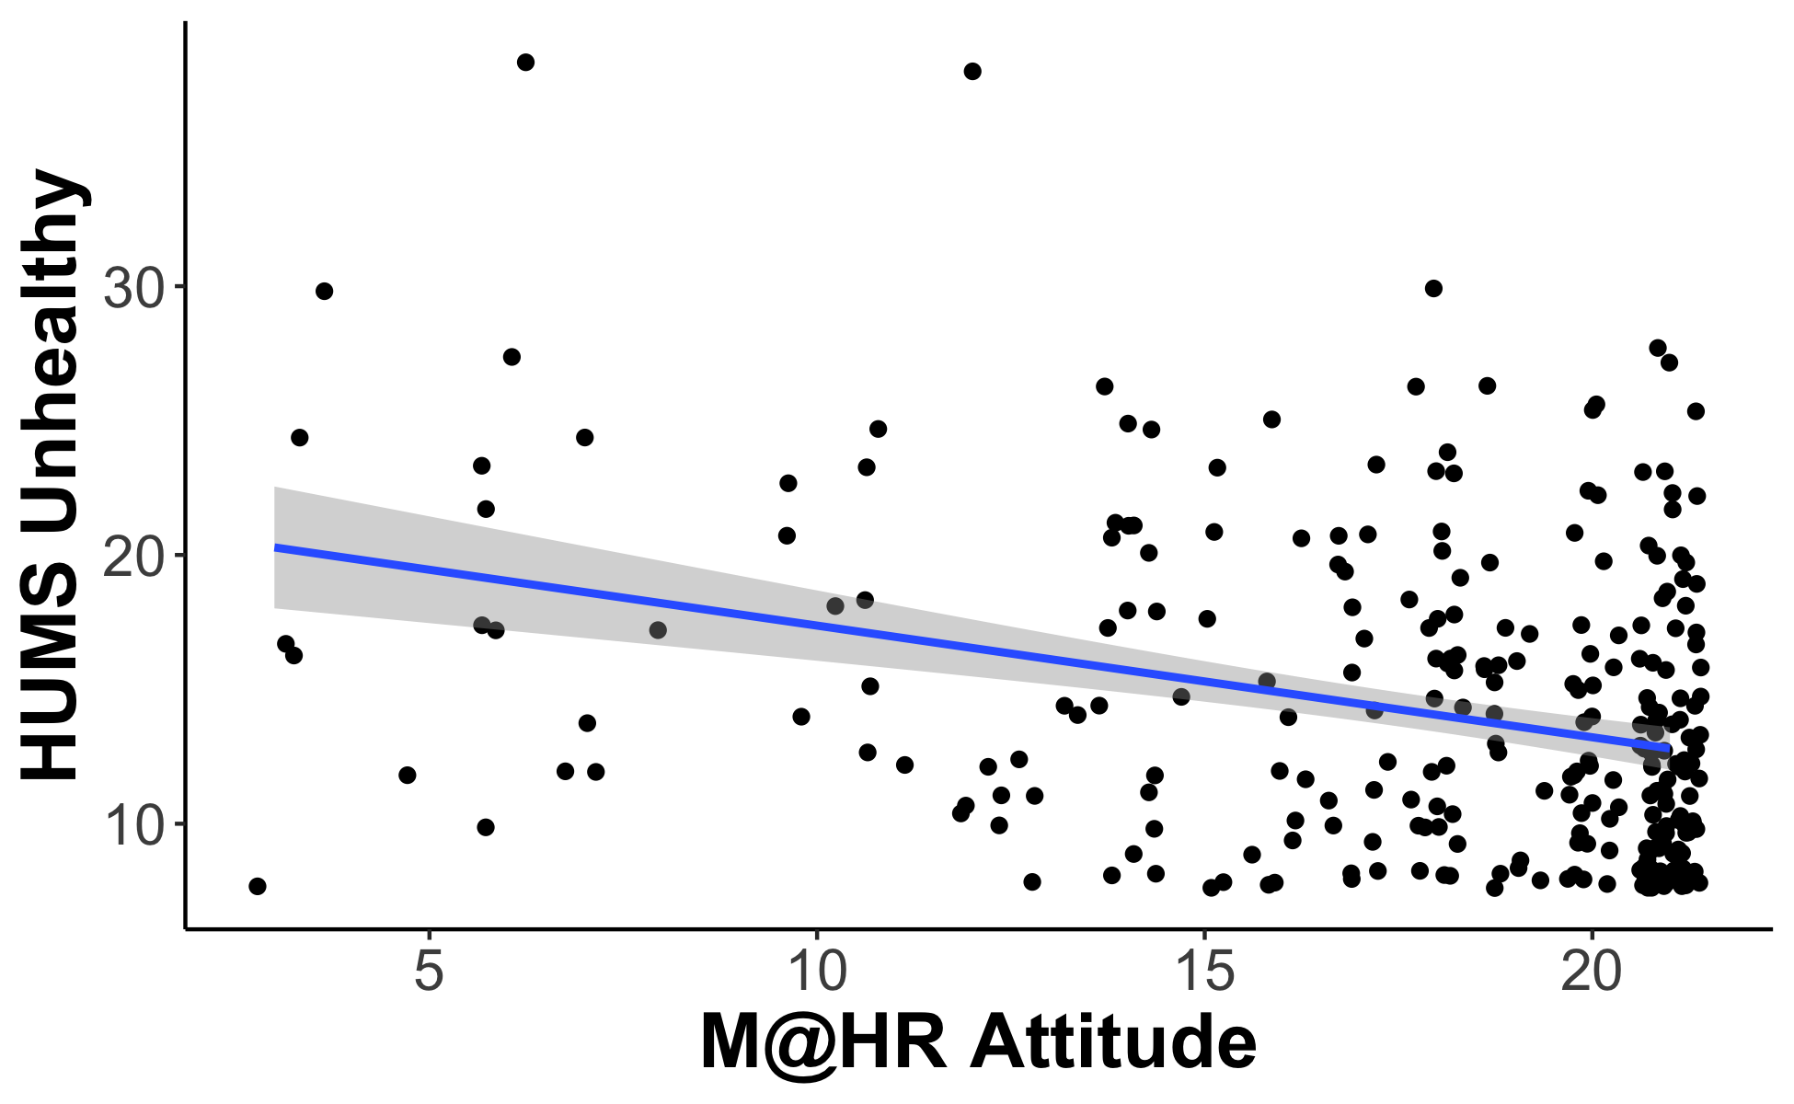
Utility of Scale: HUMS

Slide 8
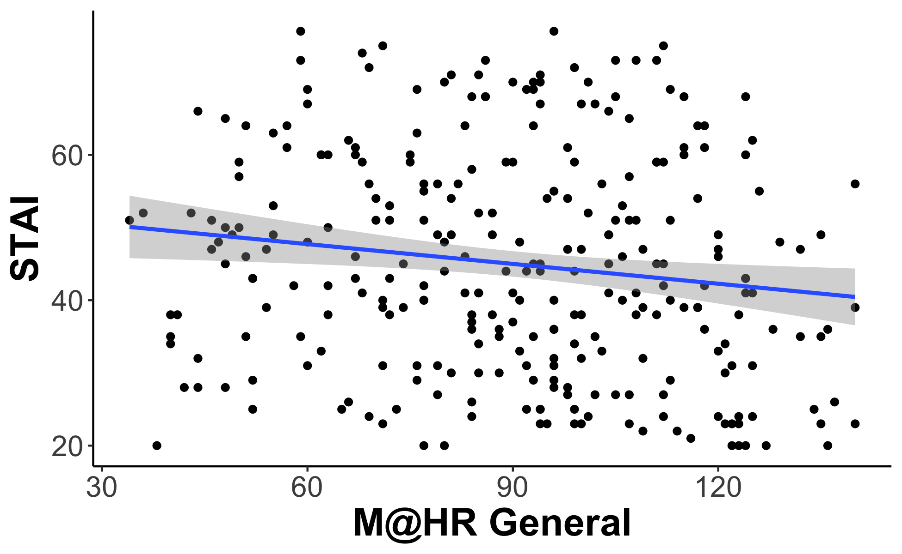
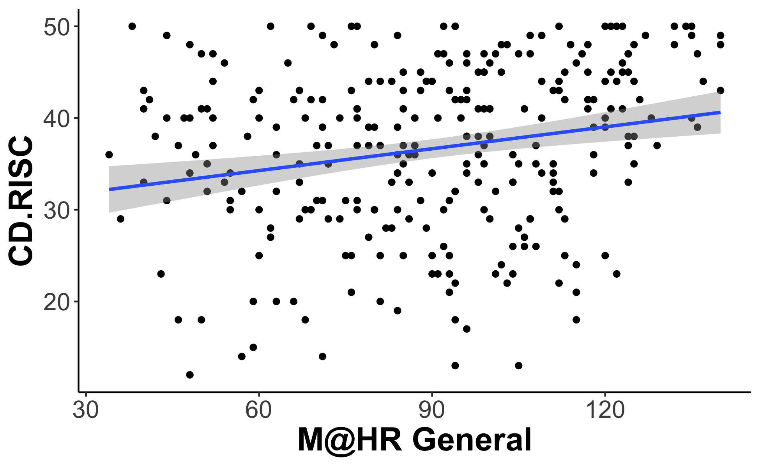
Utility of Scale: Mental Health

Slide 9
Updated Figures
Since 10/2 Meeting

Slide 10
Table 2: GoldMSI and M@H-R

Slide 11
Table 3: eBMRQ and M@H-R

Slide 12
Table 4: Adversity and M@H-R

Slide 13
Table 6: SRQ and M@H-R

Slide 14
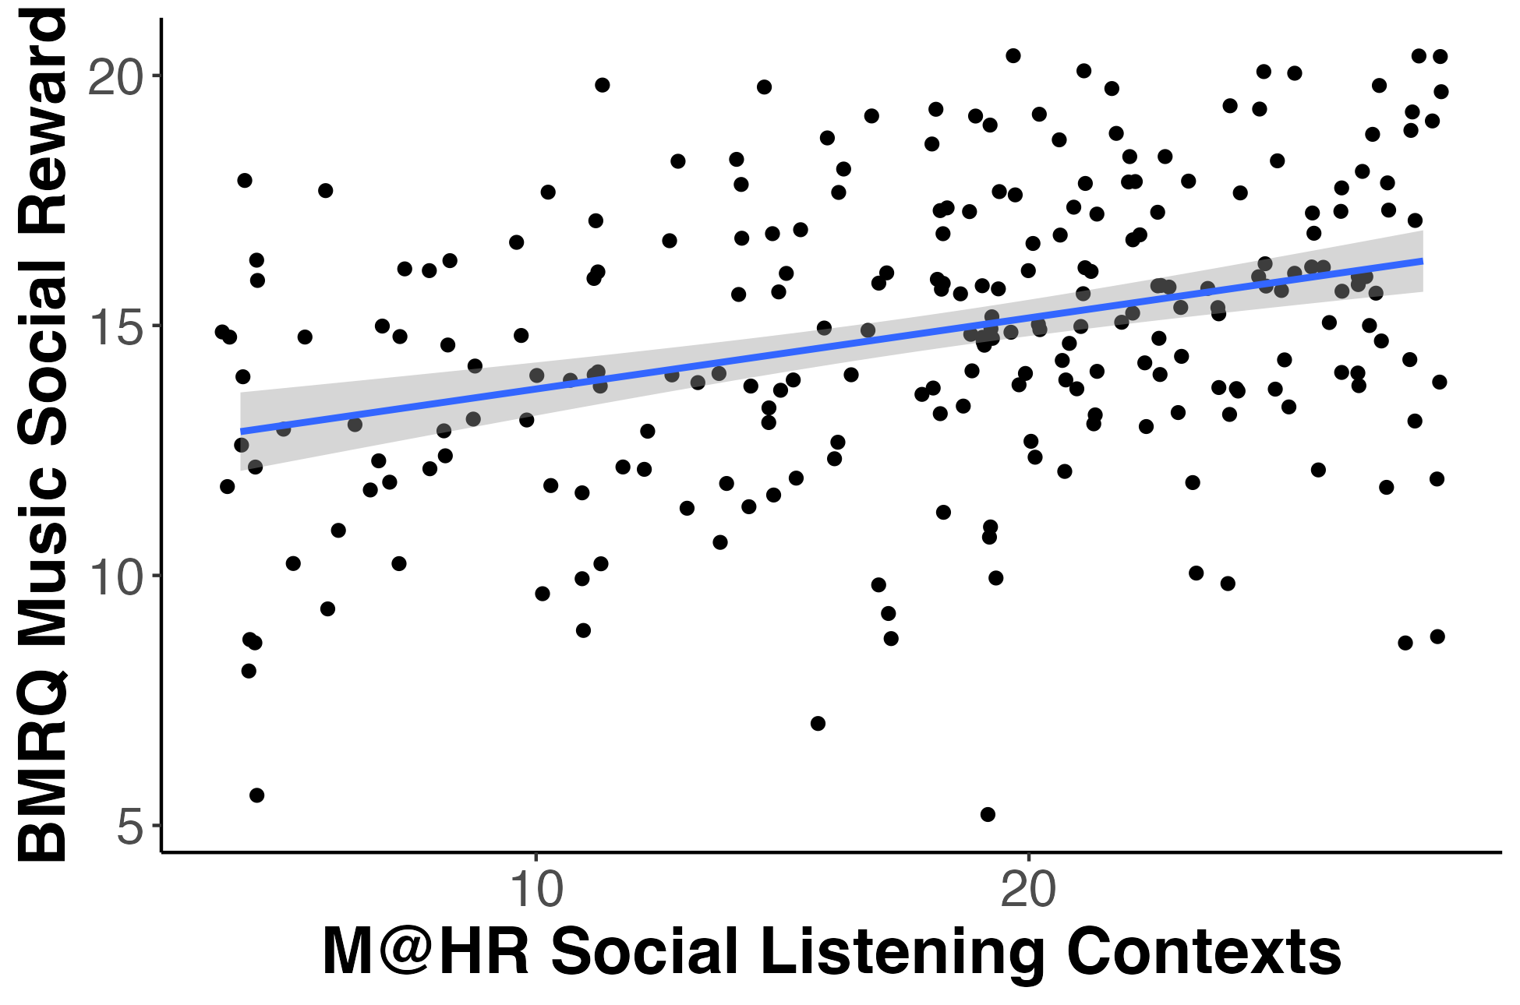
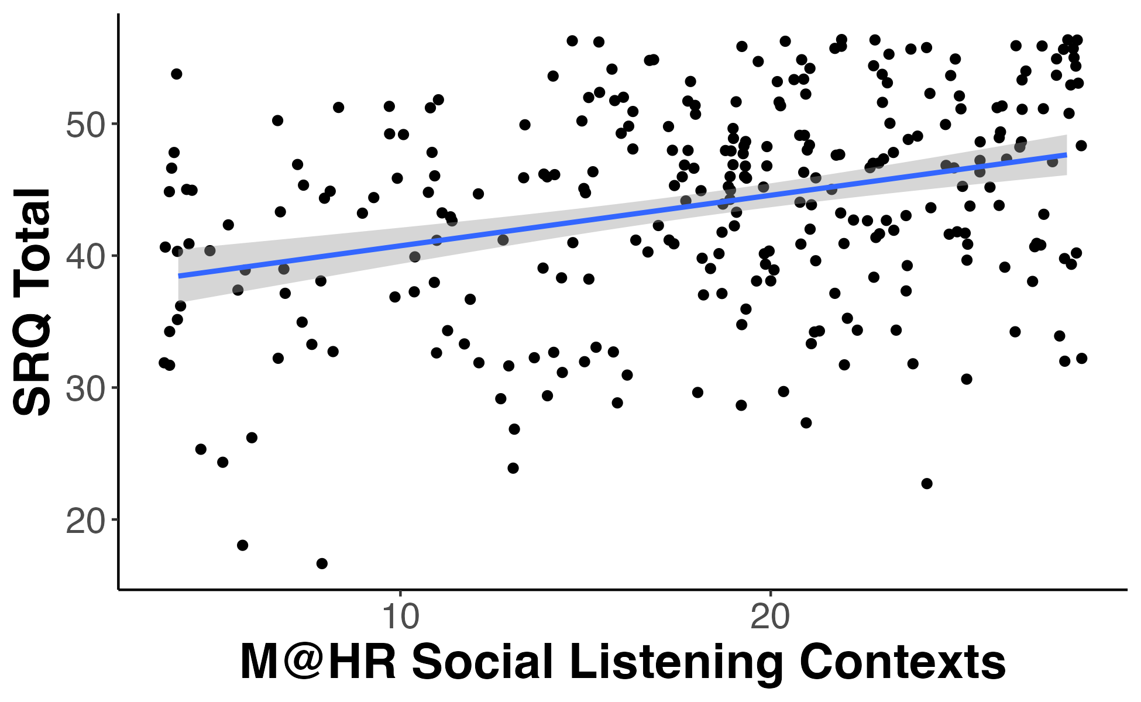
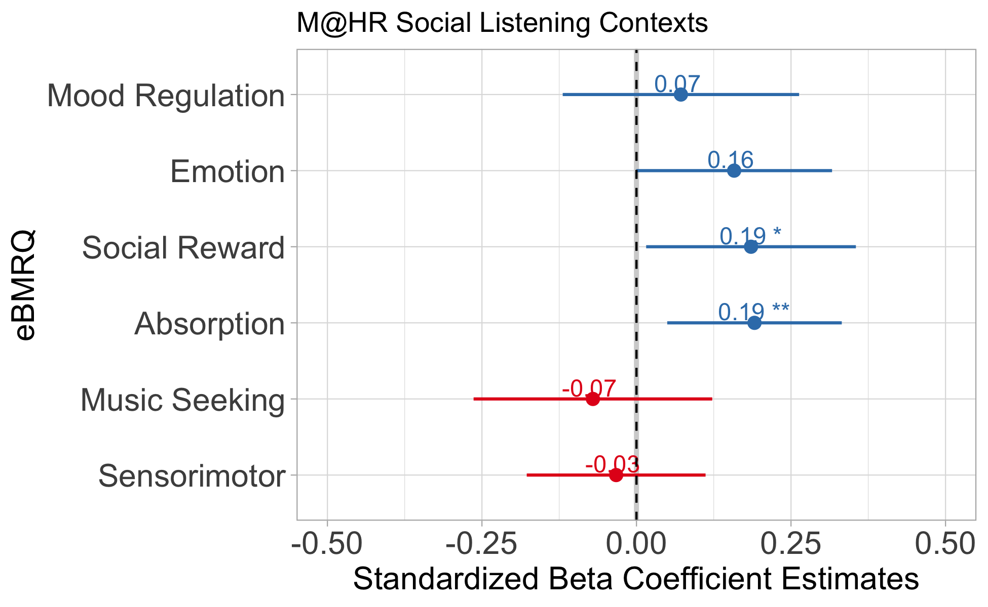
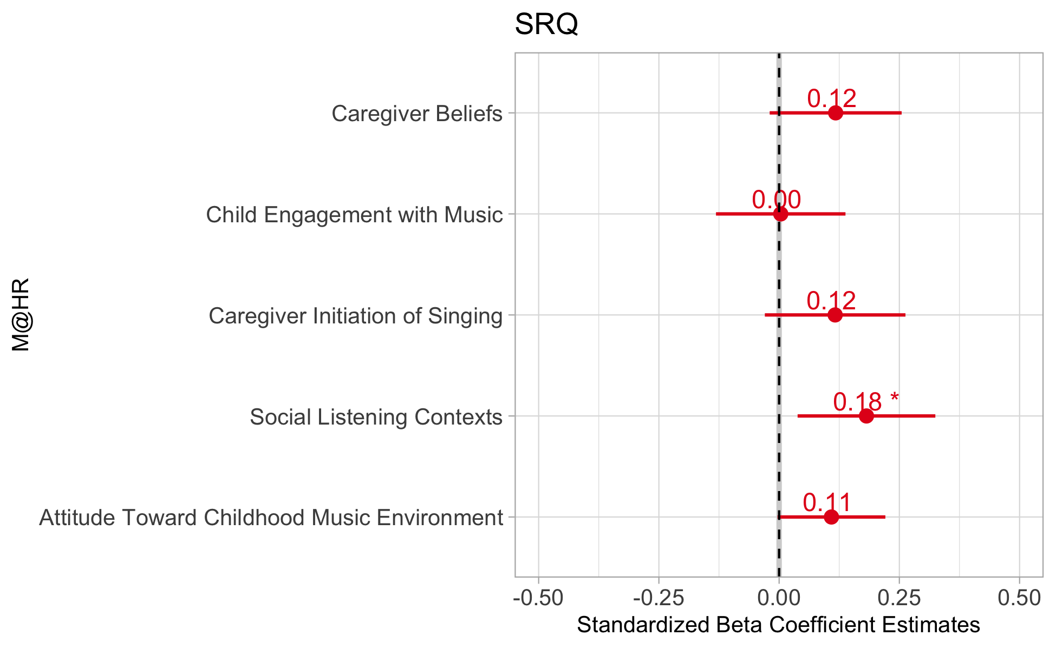
Figure 2: Social Scatters
A.
B.
C.
D.

Slide 15
Table 7: Test-Retest ICC

Slide 16
Figure 3: MET
A.
B.
C.

Slide 17
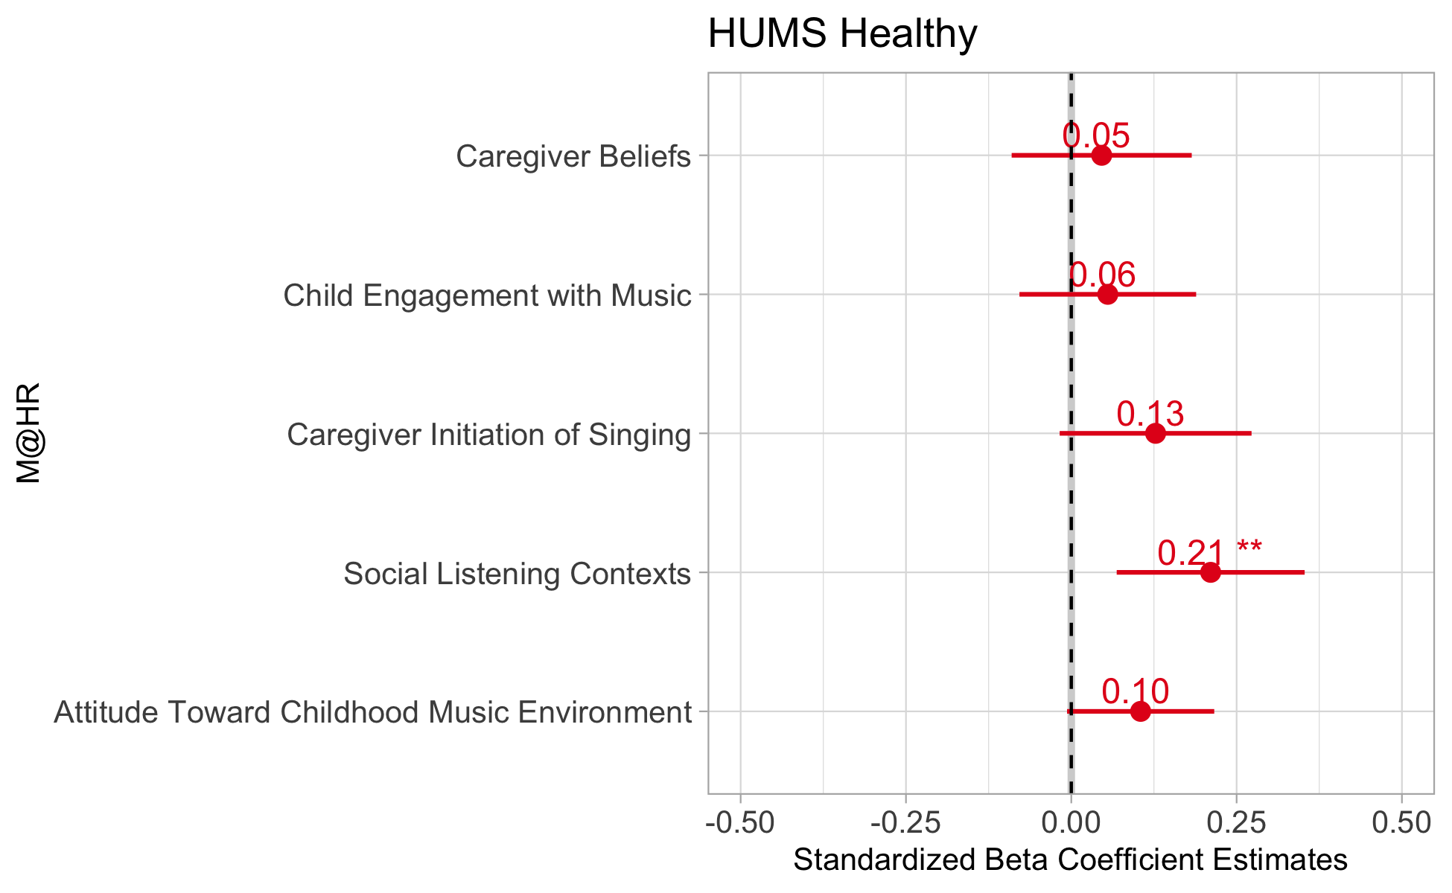
Figure 4: HUMS
A.
B.
C.

Slide 18
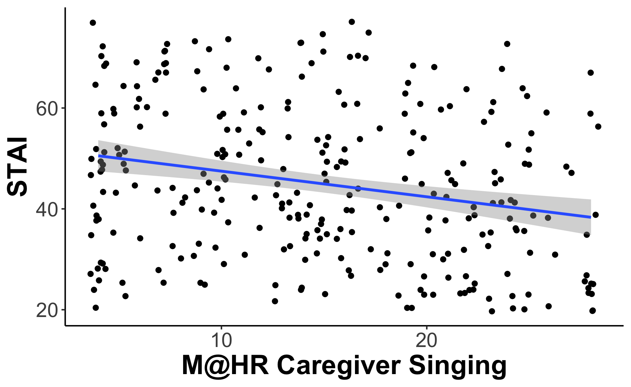
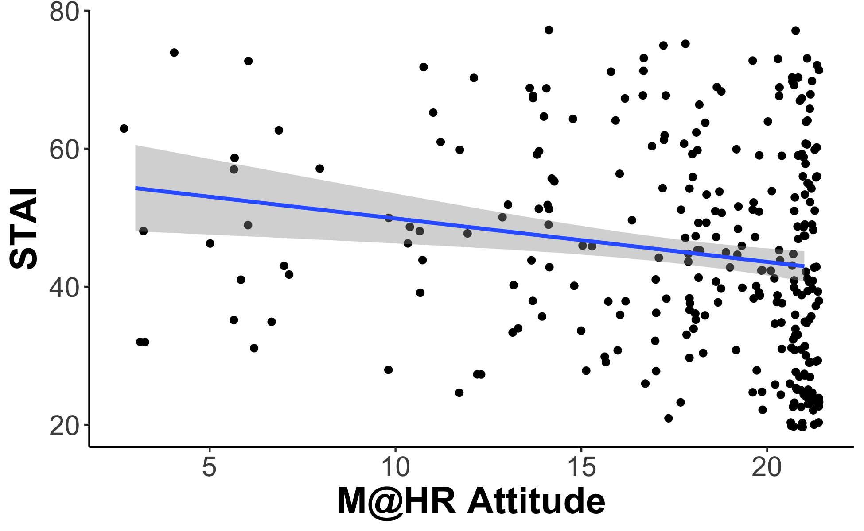
Figure 5: STAI
A.
B.
C.

Slide 19
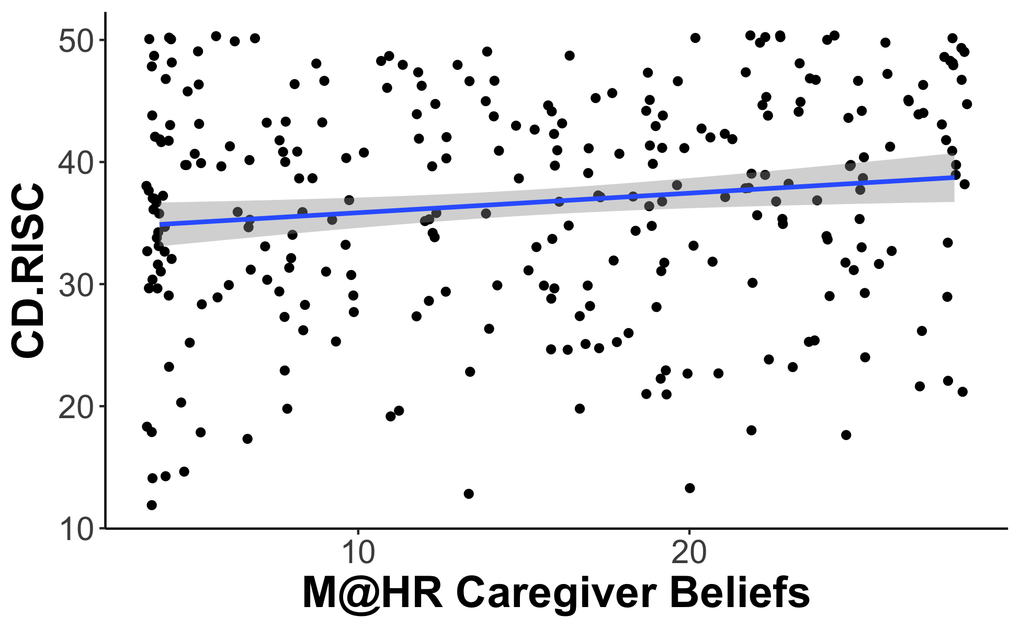
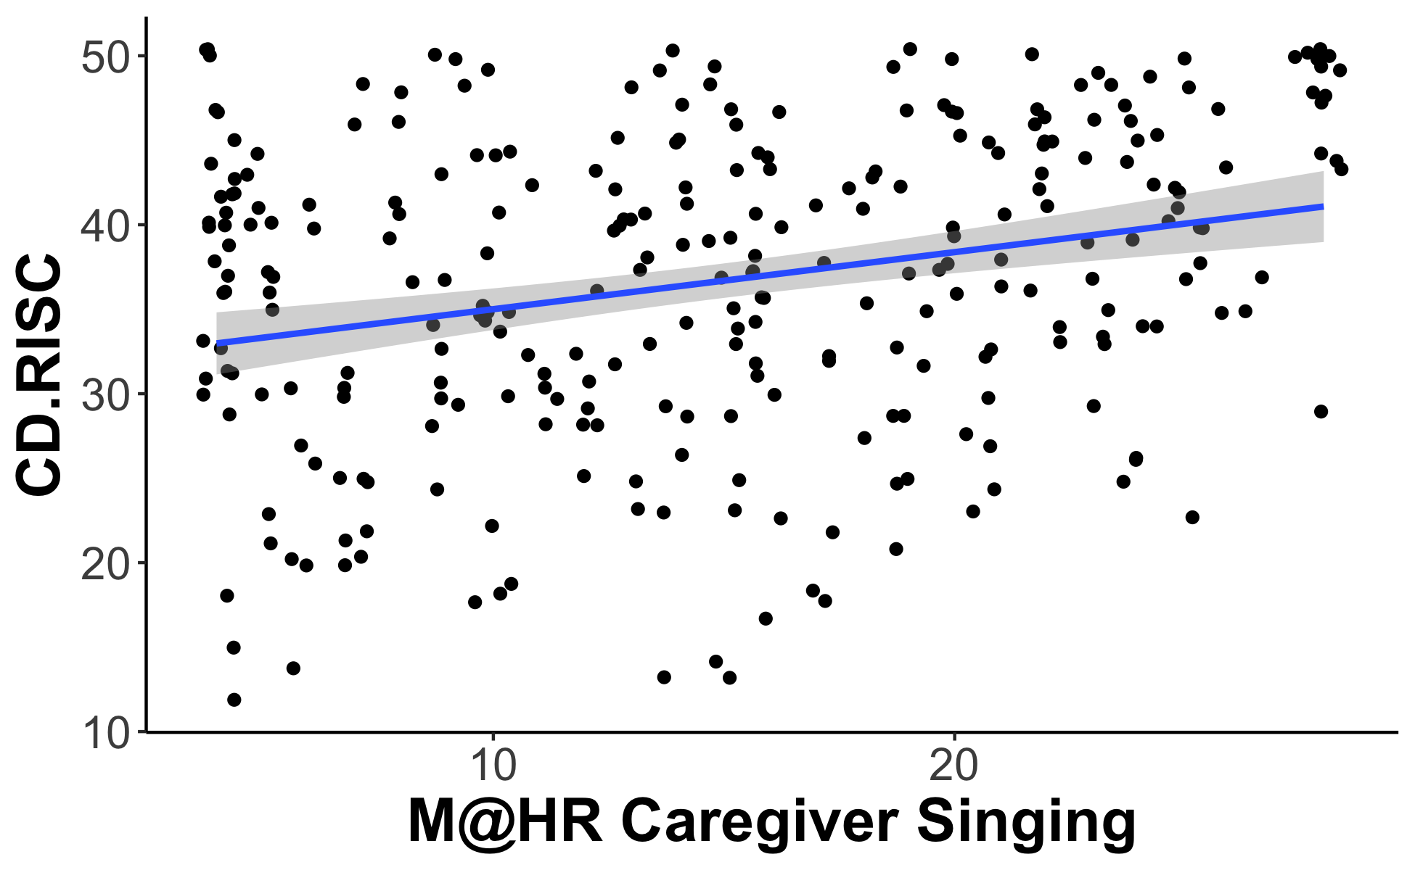
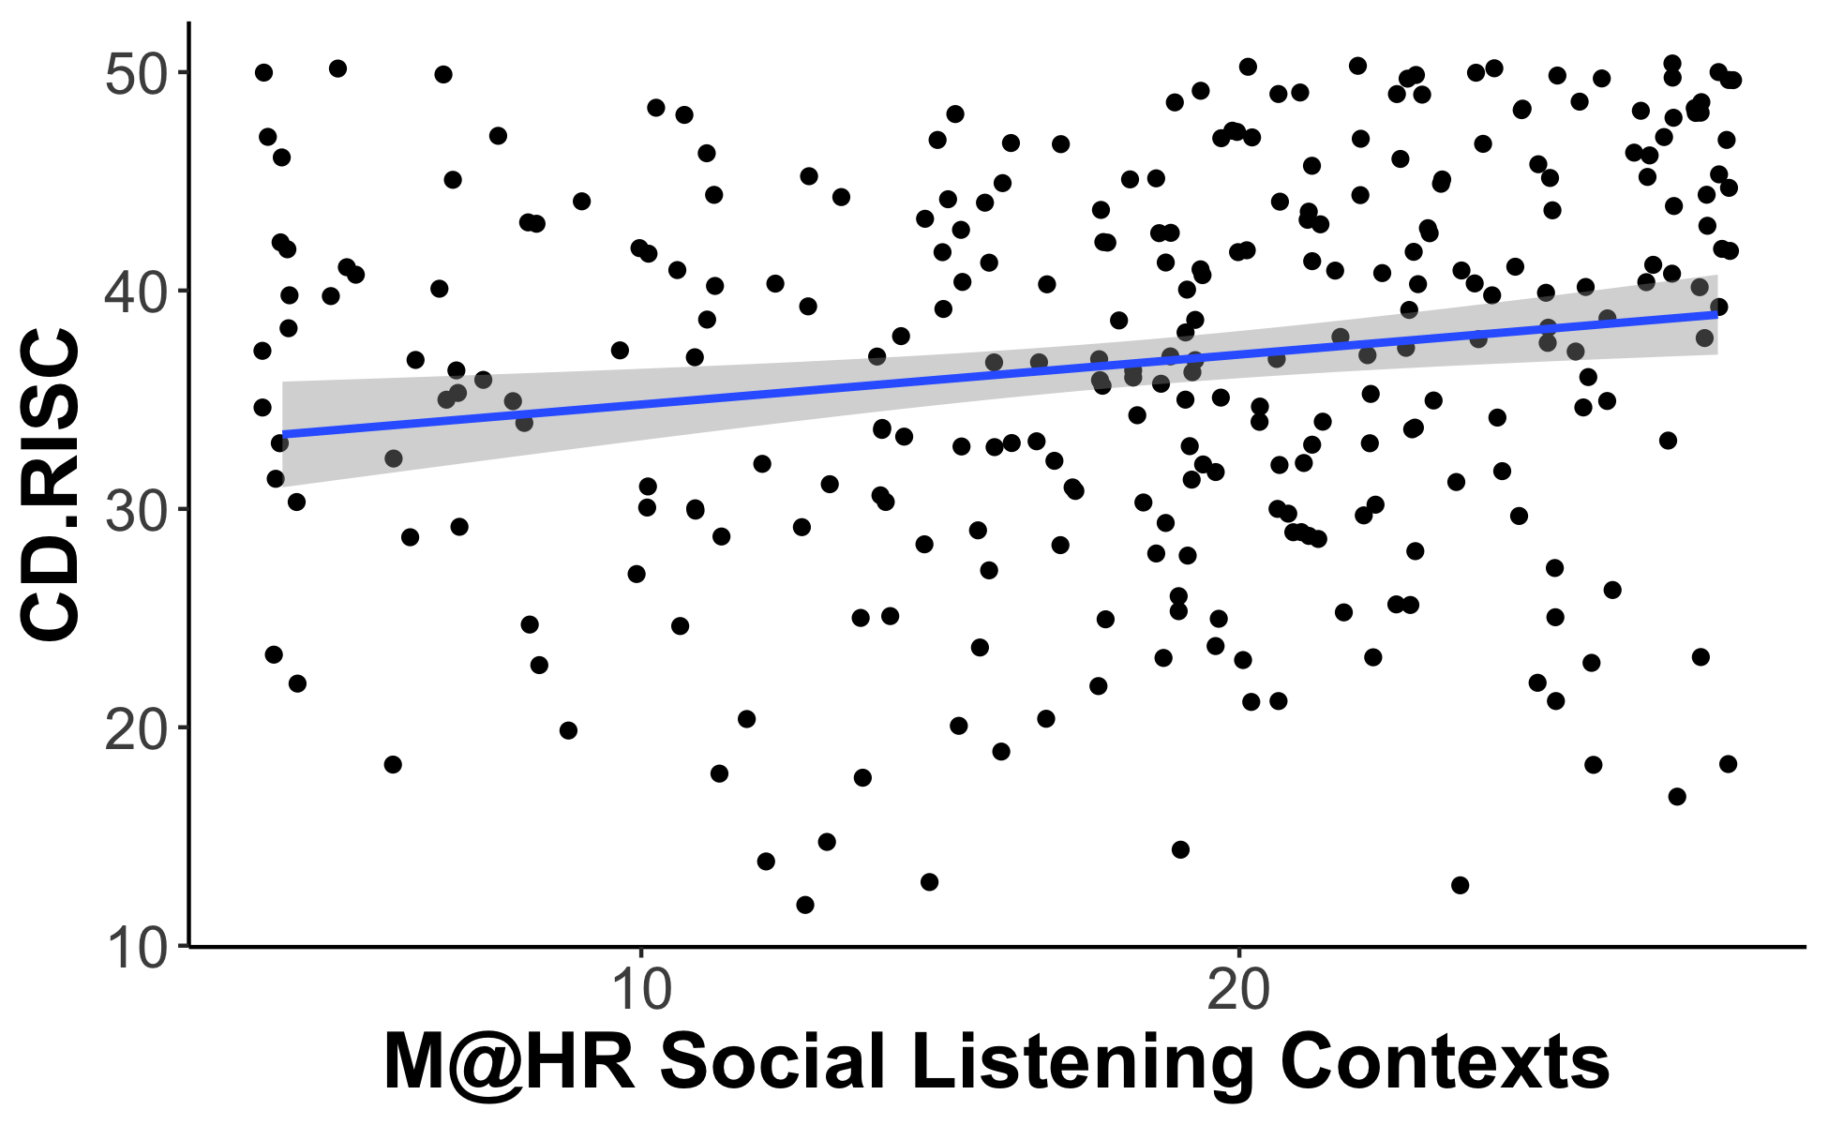
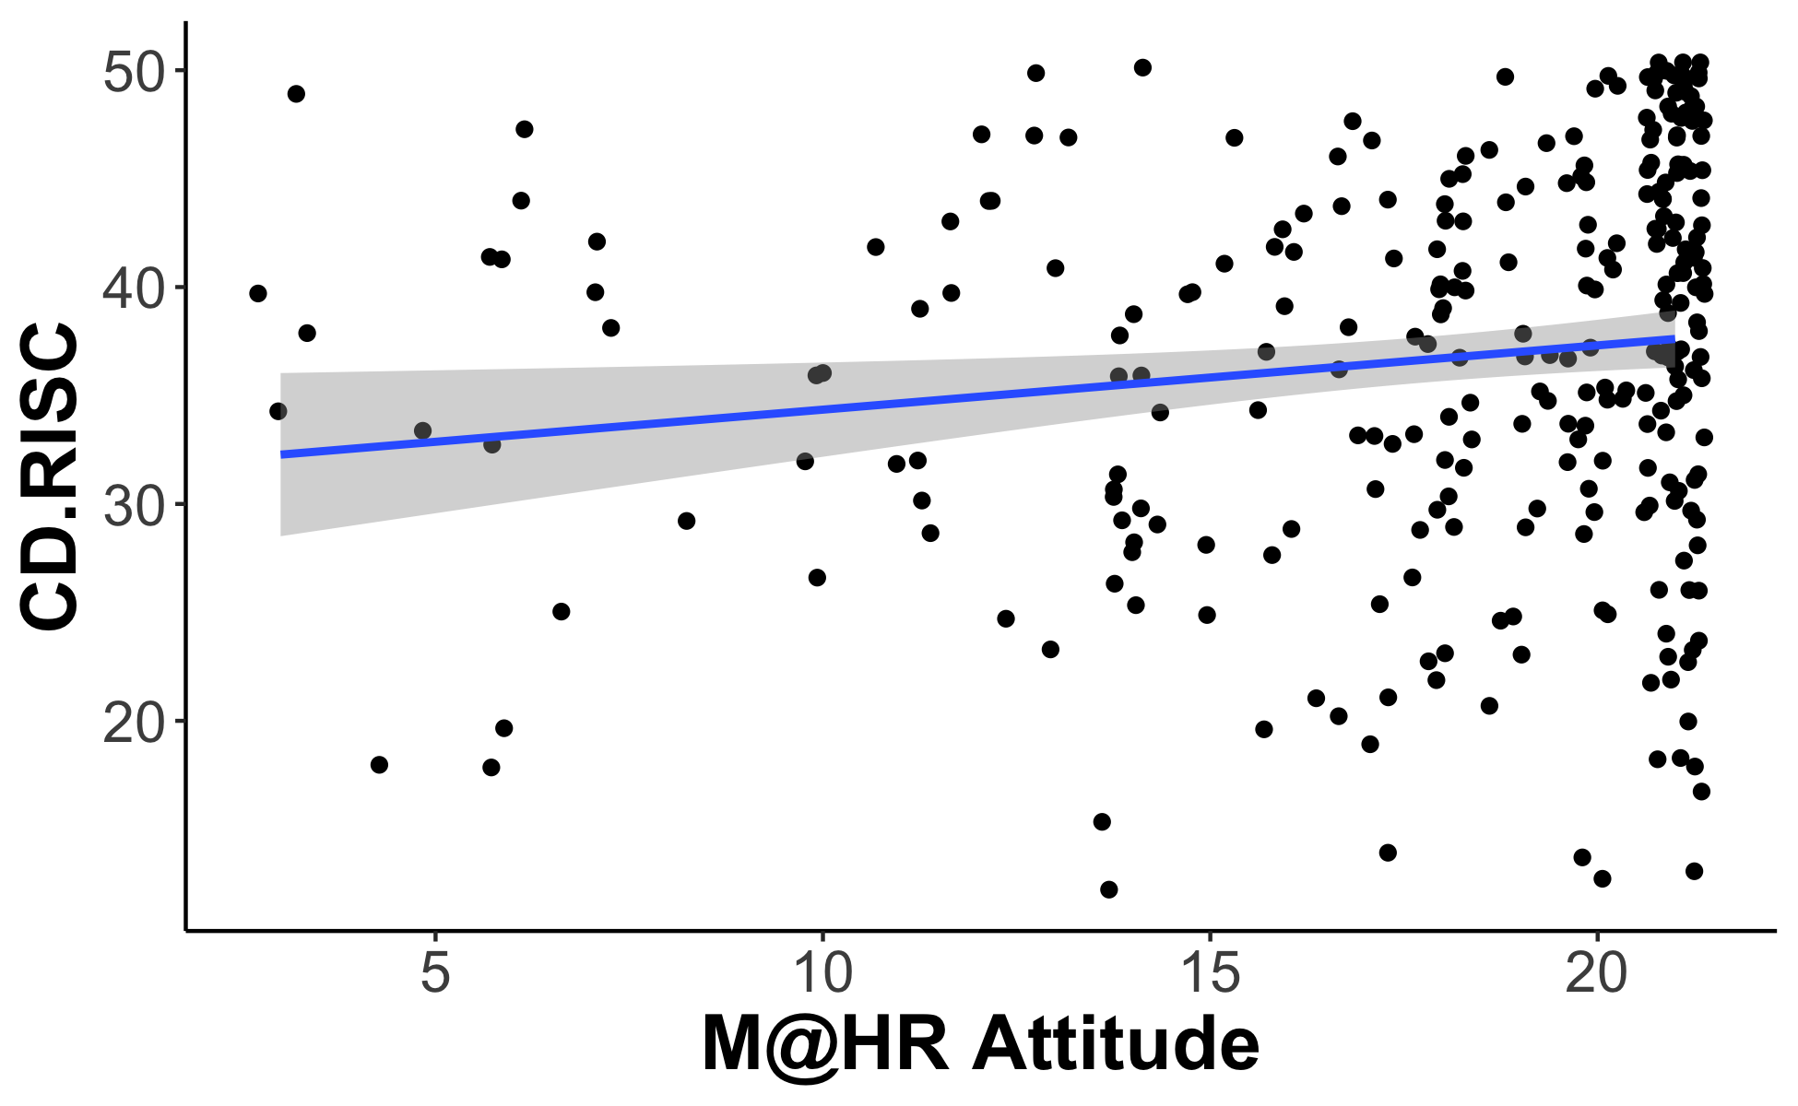
Figure 6: CD-RISC
A.
B.
C.
D.
E.

